Slide 1


STUDENT-TEACHER APPOINTMENT SYSTEM

Slide 2
Kofi Dramane
Sachin Jangoli
Induraj PR
Murali Krishna M
System Analyser & Tester
System Analyser & Tester
GUI Designer & Developers
GUI Designer & Developers
1
2
3
4

Slide 3





INTRODUCTION
APPOINTMENT
SYSTEM
TEACHER
STUDENT
Notes:
FACILITATE STUDENTS AND TEACHERS TO MAKE APPOINTMENTS WITH EACH OTHER.
PLATFORM BETWEEN STUDENT AND TEACHER TO SCHEDULE THEIR APPOINTMENTS

Slide 4



EXISTING SYSTEM
Ufff..!
Again he is not in office
Notes:
STUDENT IF HE NEEDS TO MEET A TEACHER, HE HAS NO IDEA OF WHEN TEACHER WILL BE AVAILABLE IN HIS OFFICE.
IT’S TIRESOME PROCESS FOR THE STUDENT TO GO EVERY TIME TO TEACHER OFFICE TO CHECK IF THE TEACHER IS AVAILABLE!
Teacher if he needs to meet a random student in the class he teaches, he has no computerized mechanism to communicate with that student of his choice
Record of appointment made either by student or teacher is not well kept
Difficult to track and manage the appointments
Record of appointments are not kept

Slide 5



PROPOSED SYSTEM
Notes:
if a student wants an appointment with a teacher, he first checks the free time listed by the particular teacher and if the mentioned time interests the student then student request teacher for an appointment.
Similarly, the teacher can also request a student to meet him at a particular time!

Slide 6








SCOPE

Slide 7
To register teachers and student information’s.
To update or delete teacher and student information’s.
To assign teacher to a particular course and department.
To enroll a student to a particular course.
Teacher entering his consultation hours.
Teacher requesting a student to meet him during consultation hours.
Student requesting a teacher for appointment .
Teacher accepting or deleting appointments made or given to him.

Slide 8
Perfomance Requirements
Functional Requirements
Process Requirements

Slide 9
Performance Requirements
We believe that the codes are as simple as possible thereby reducing the time and space complexity thereby achieving greater performance.
Process Requirements
The system allows admin to add, modify/delete and assign departments and courses to teachers/students.
The system allows teacher to set/change his consultation hours.
The system allows teacher to give/view/delete the appointments.
The system allows student to edit his profile, enroll in a particular course.
The system allows student to view the schedule i.e. consultation hours of teachers.
The system allows student to request a particular teacher to give appointment.

Slide 10

NON FUNCTIONAL REQUIREMENTS
GUI USER FRIENDLY
SECURE
EASY TO USE
RELIABLE
24x7 AVAILABLE

Slide 11


Slide 12
USE CASE DIAGRAM

Slide 13
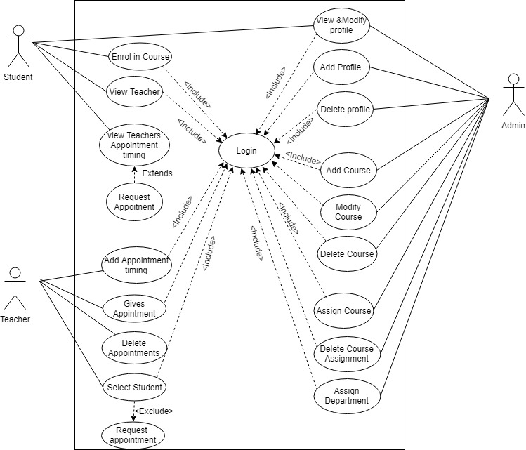

Slide 14
CLASS DIAGRAM

Slide 15
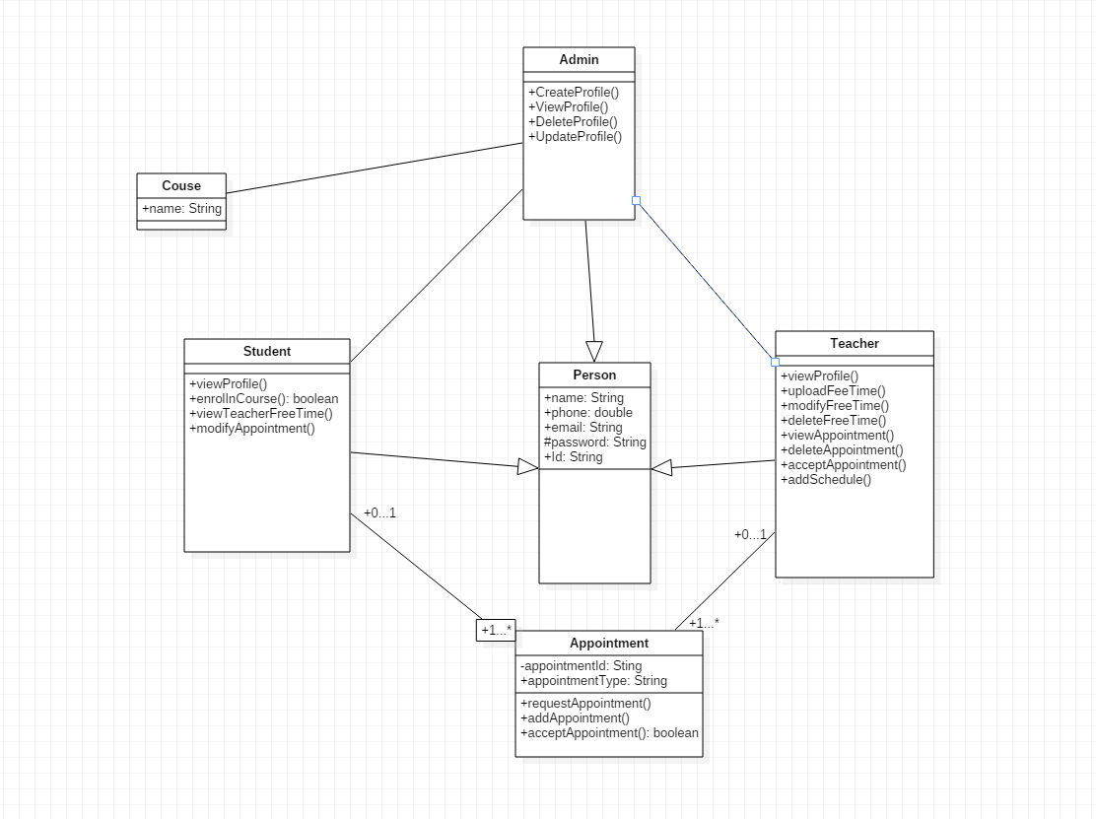

Slide 16
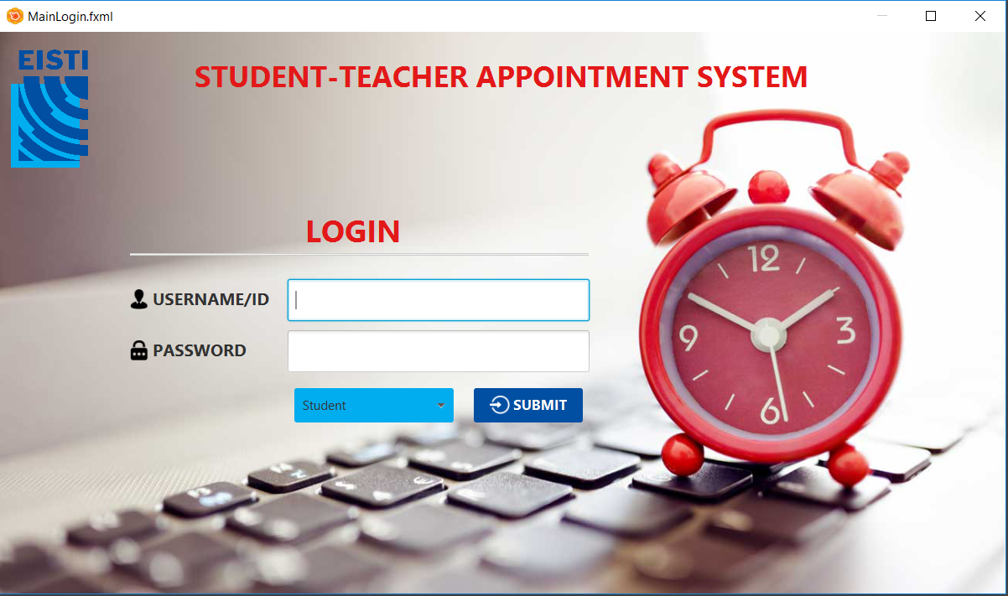
Project Implementation
Place your screenshot here

Slide 17





DEVELOMENT TOOLS
Eclipse IDE
WAMP Server
SceneBuilder
Lucid Chart
Icons8

Slide 18


Teacher is supposed to enter only one free schedule (consultation hour)!
Teacher is not provided the facility of entering many different consultation hours in bulk for a couple of days or for whole week or for whole month of his choice
Giving appointment for a particular time slot within consultation hours can be added
Modifying the appointment and managing time slots can be further added.

Slide 19


